Slide 1

Overcoming Barriers in Building Retrofits: Integrating Advanced Technologies for Enhanced Comfort and Energy Efficiency.
Journal of Sustainable Development of Energy, Water and Environment Systems
07 - 10 – 2025
Presented by: Boniface Dominick Mselle

Slide 2
Table of contents
01
Motivation
04
Results
What is the core problem?
Discussions and findings?
02
Introduction
05
Conclusions
What is the state of the art?
What are the main findings?
04
Methodology
06
Acknowledgements
How do we achieve the solutions?
Thank you all

Slide 3
01
Motivation
What is the core problem?

Slide 4
Motivation
Key motivations and issues identified
Traditional simulation methods often fail to reflect actual building performance
Simulations overlook the occupant behavior
There's a need for better decision-making tools for renovation strategies that consider real-world usage patterns and conditions.
Solution in a Case study
  The buildings under study (1970s-era apartments in Spain):
    High theoretical energy demand (151–300 kWh/m²·year).
    Poor energy efficiency (rated E).
    Does the actual energy consumption, reflect to the theoretical value?

Slide 5
02
Introduction
What is the state of the art?

Slide 6
Introduction
Key trends and state of the art
Why Building Retrofits Need More than Models
  Buildings = 34% of global energy use & 37% of CO₂ emissions.
  Retrofitting is essential, especially in aging European housing stock.
  Performance gap = "efficient on paper" but poor indoor quality in practice.
  Social housing is particularly at risk → energy poverty, thermal discomfort, and health risks.
  EPBD (2024/1275): requires Indoor Environmental Quality (IEQ) as part of energy standards.
  Literature highlights:
    Retrofits don’t always improve IEQ (sometimes worsen pollutants/ventilation).
    Need for hybrid approaches → monitoring + models.

Slide 7
03
Methodology
How do we achieve the solutions?

Slide 8
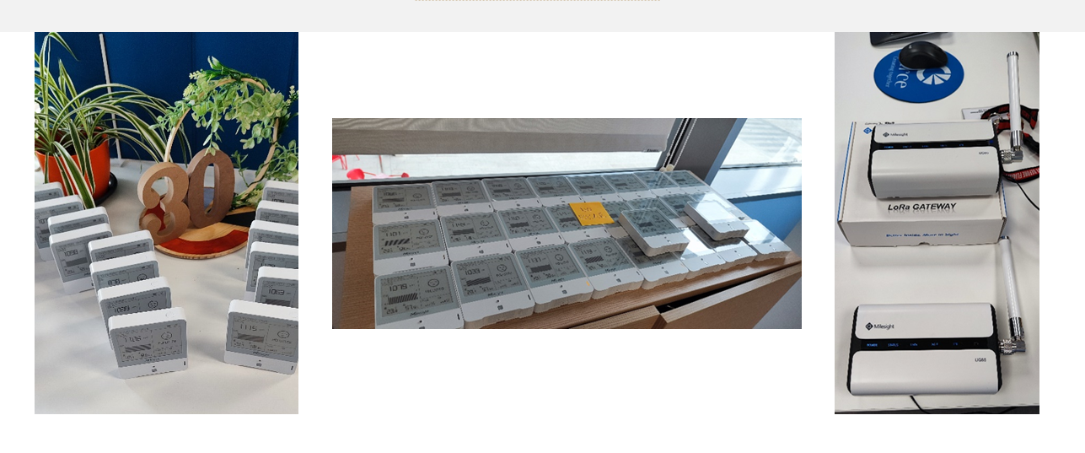

Methodology
Key steps, infrastructure, and processes
Data acquisition components
Data acquisition
IEQ
Electricity consumption
Thermal energy consumption
Dedicated monitoring system
Datadis online platform
gas utility bills

Slide 9
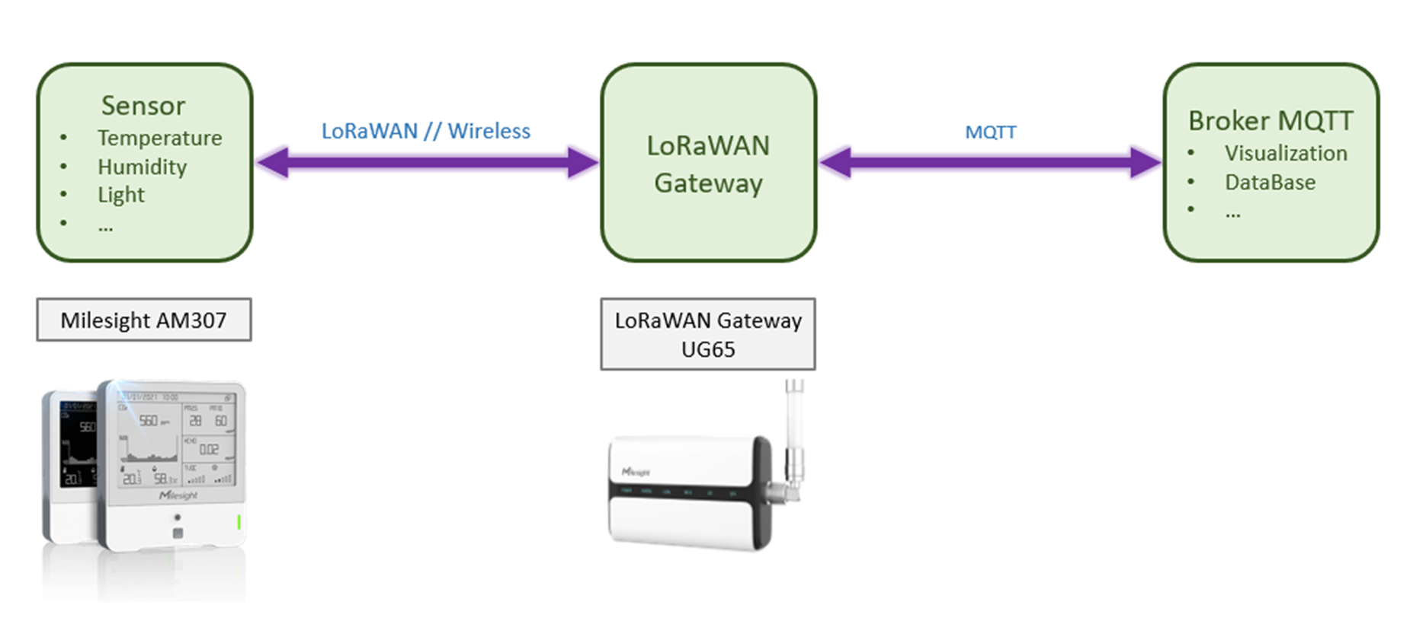
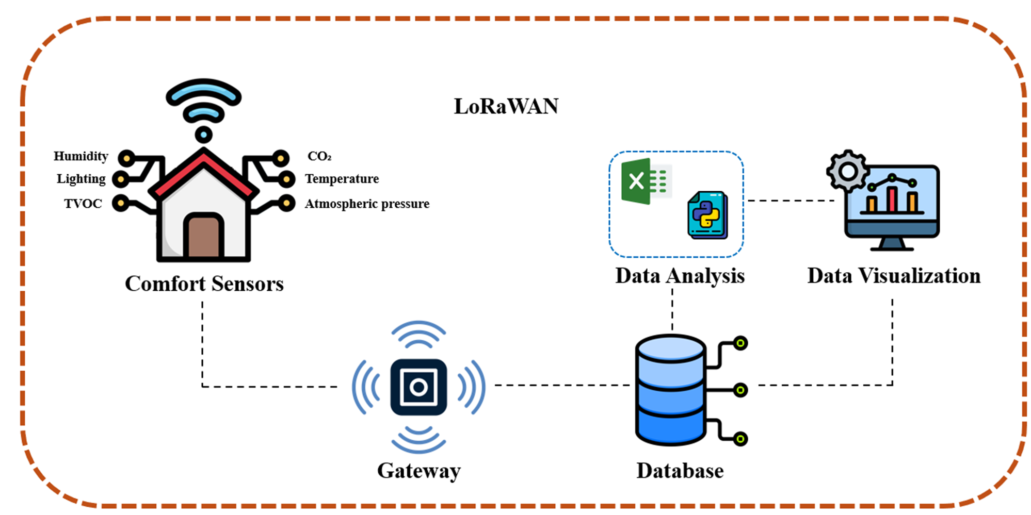
Methodology
Key steps, infrastructure, and processes
IEQ Infrastructure

Slide 10
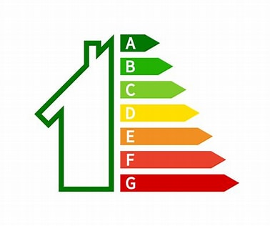



Methodology
Key steps, infrastructure, and processes
Evaluation
Analytics
EPCs
UNE
Customized ranges
WELL
Literature references

Slide 11
Methodology
Key steps, infrastructure, and processes
Evaluation
Parameter | unit | low | Optimal | High
Temperature (air) | ºC | <20 | 23-26 | ≥25
Relative humidity | % | <30 | 40-60 | >60
CO2 | ppm |  | <750 | >1000
TVOC | µg/m³ |  | <300 | >1000
Illuminance | lux | <500 | ≥500<2000) | ≥2000

Slide 12
04
Results
Discussions and findings?

Slide 13
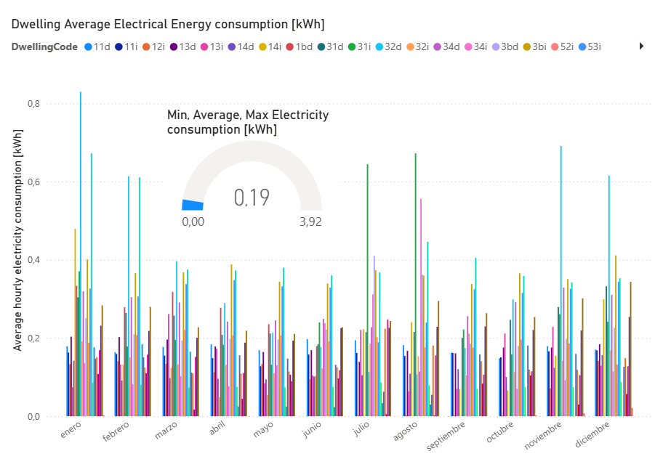
Results
Electricity consumption

Slide 14
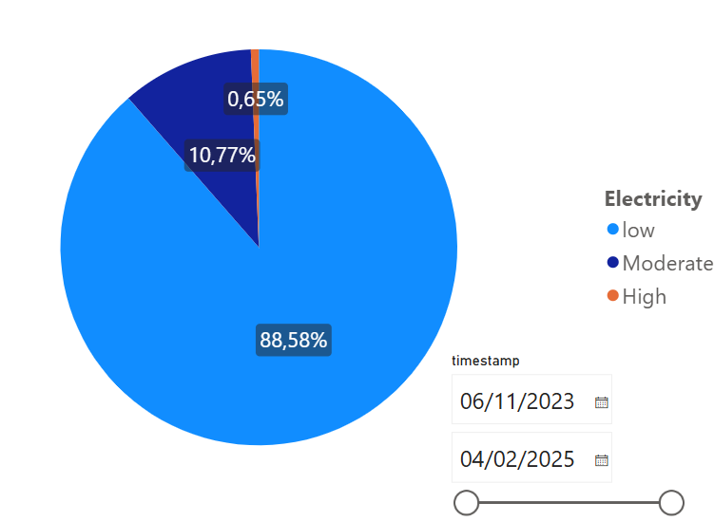
Results
Electricity
consumption
Hourly electricity
  Low: < 0.1 kWh)
  Moderate: 0.1 kWh - <1 kWh
  High: > 1 kWh

Slide 15
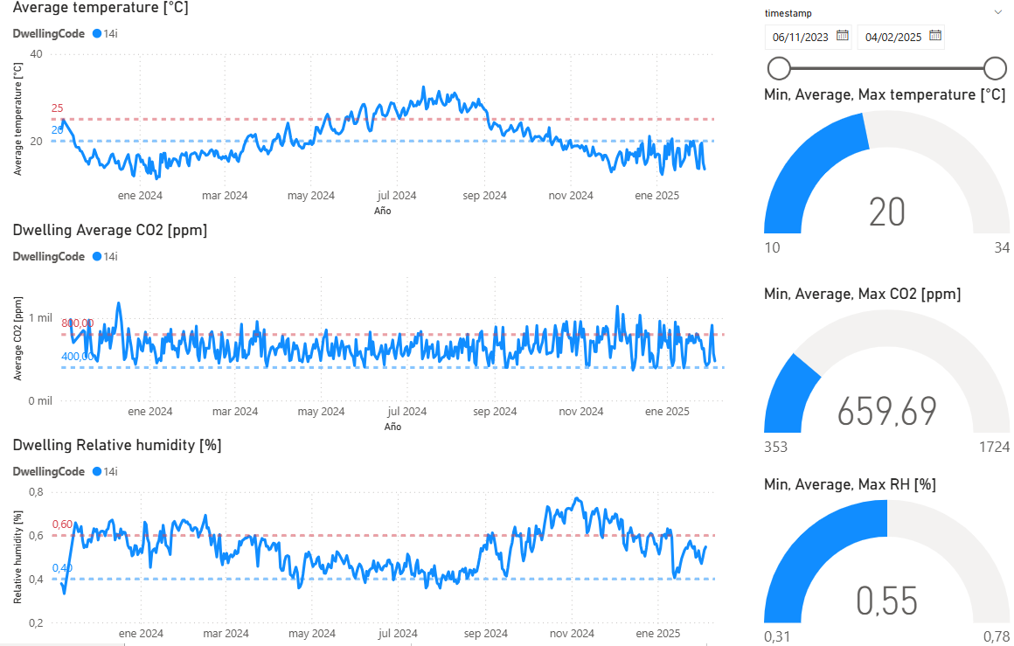
Results
IEQ
Selected apartment
  Temperature
  CO2
  Relative humidity

Slide 16
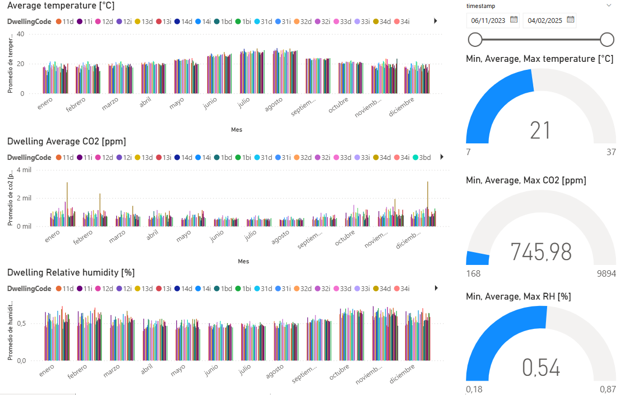
Results
IEQ
All buildings
  Temperature
  CO2
  Relative humidity

Slide 17
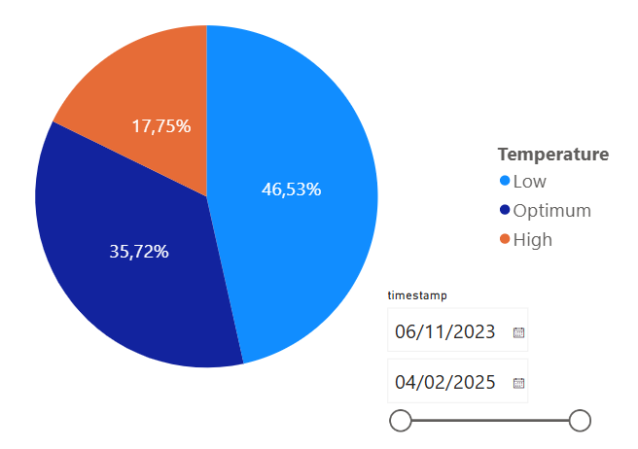
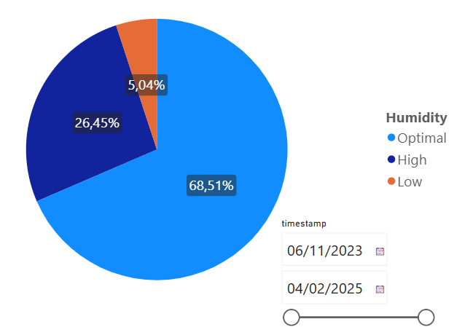
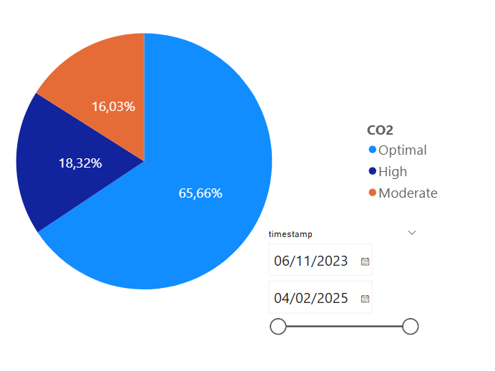
Results
IEQ
All buildings
  Temperature
  CO2
  Relative humidity

Slide 18
05
Conclusions
What are the main findings?

Slide 19
Conclusions
What are the main findings?
What was done in this study?
Data-driven diagnostic approach applied to deep renovation projects in Zaragoza, Spain
Integration of real-time monitoring and established benchmark perspectives
What are the main findings?
Revealed gaps between theoretical and actual performance on energy consumption
  Measured energy use lower than EPC projections
  Indoor comfort often sub-optimal
  ~50% of monitored time below recommended temperature thresholds
  Frequent CO₂ exceedances in winter → insufficient ventilation
Highlights the limits of simulation-only assessments → need for empirical diagnostics
What is the suggested future work?
  Expand framework with post-intervention data to assess performance after renovations works
  Policy implication: integrate comfort indicators into energy certification schemes

Slide 20
06
Acknowledgements
Thank you all!

Slide 21
Acknowledgement
This paper is based on the experience and results gained from InCUBE; a project co-funded by the Horizon Europe (HORIZON) of the European Commission under grant agreement No. 101069610. (InCUBE: An Inclusive Toolbox for Accelerating and Smartening Deep Renovation).

Slide 22
976 976 859
bdmselle@fcirce.es

