Slide 1




BIM for Digital Twin: the case study of Trento
Silvia Ricciuti¹, Oscar Roman², Elisa Farella², Andrea Gobbi³, Diego Viesi¹, Fabio Remondino²
¹ FBK - Center for Sustainable Energy (SE)
²FBK - Center of 3D Optical Metrology
Fondazione Bruno Kessler (3DOM)
³FBK – Center of data Science for Industry and Physics (DSIP)
sricciuti@fbk.eu www.fbk.eu

Slide 2

Agenda InCUBE
Project description
Activity description
Process of the activity
Results
Conclusion

Slide 3
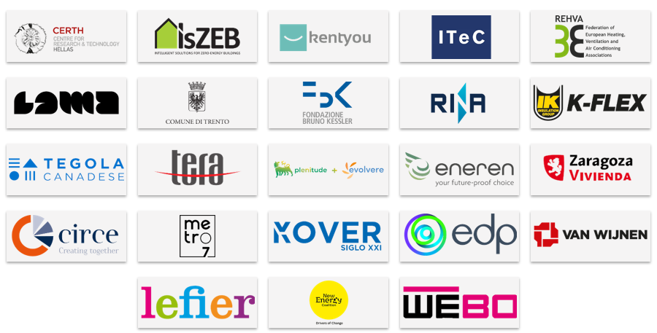
EU project InCUBE - An INClUsive toolBox for accElerating and smartening deep renovation
Partners:
InCUBE is a Horizon project in the field of Efficient, sustainable and inclusive energy use.
Keywords: off-site manufacturing, digital twins, digital logbook, robotic systems, smart readiness, lean construction, upskilling workforce, social inclusiveness, user comfort, renewable energy communities.
The project duration is from July 2022 (M1) to June 2027 (M60). From July 2026 to June 2027 there should be the one monitoring year.

Slide 4
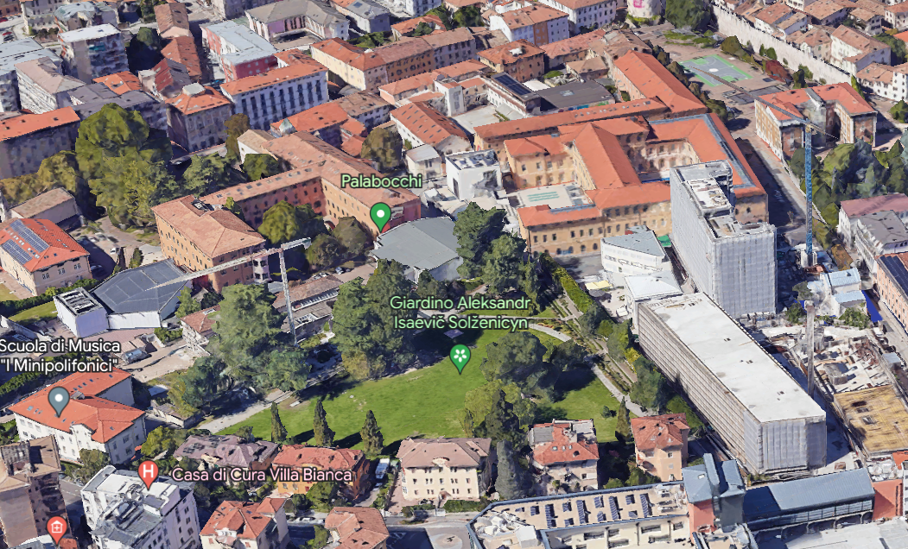
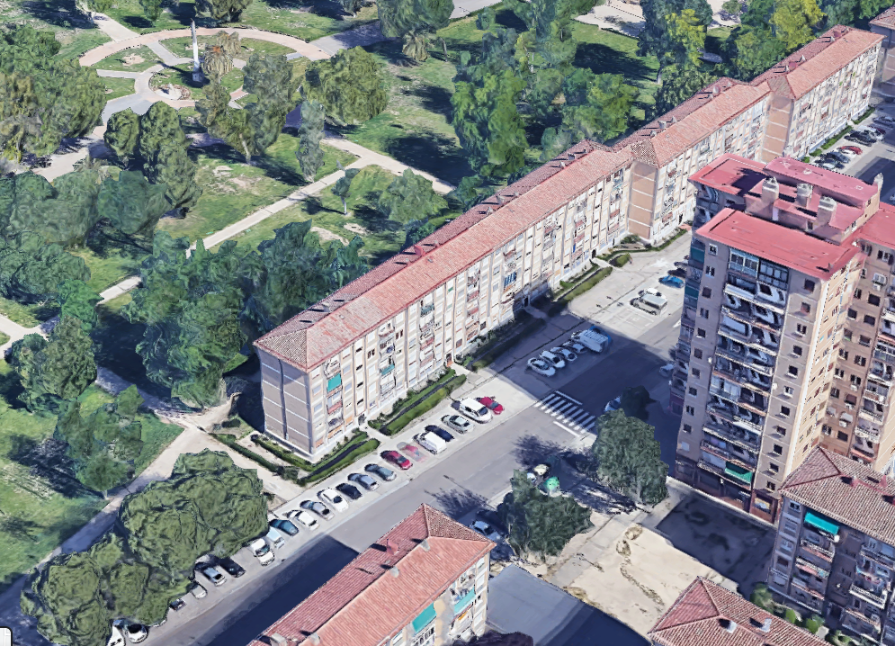
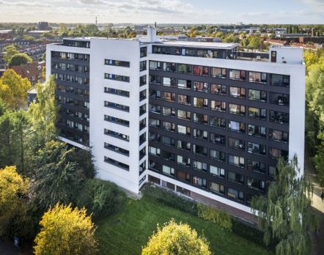
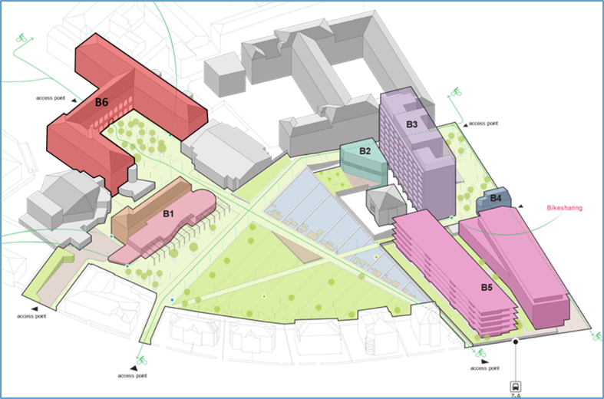
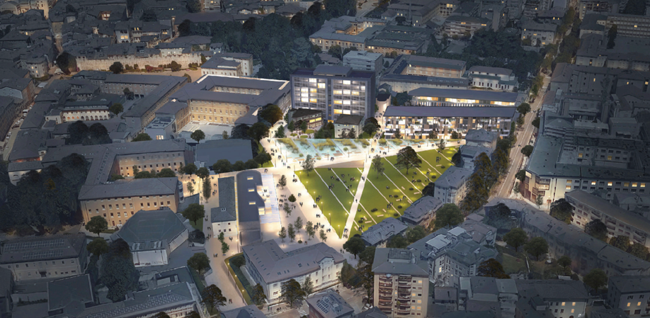
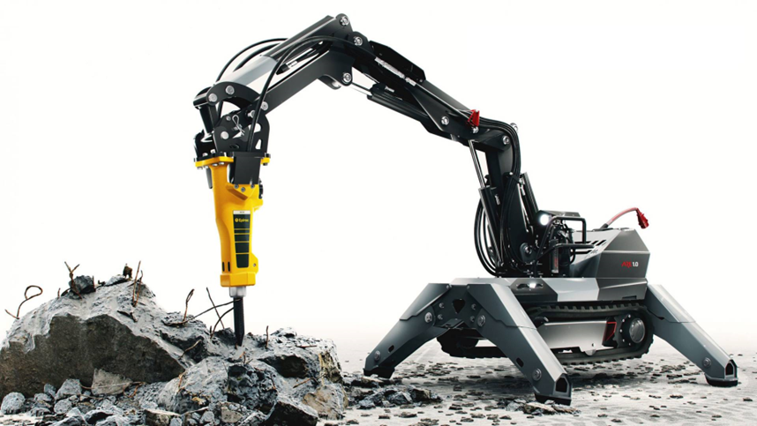
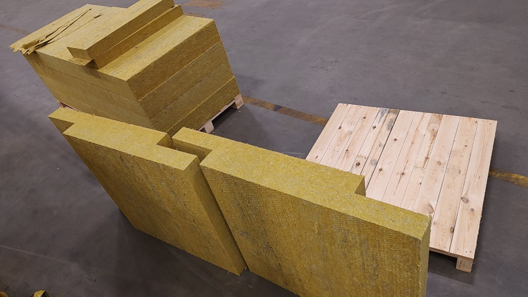
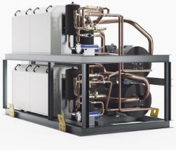
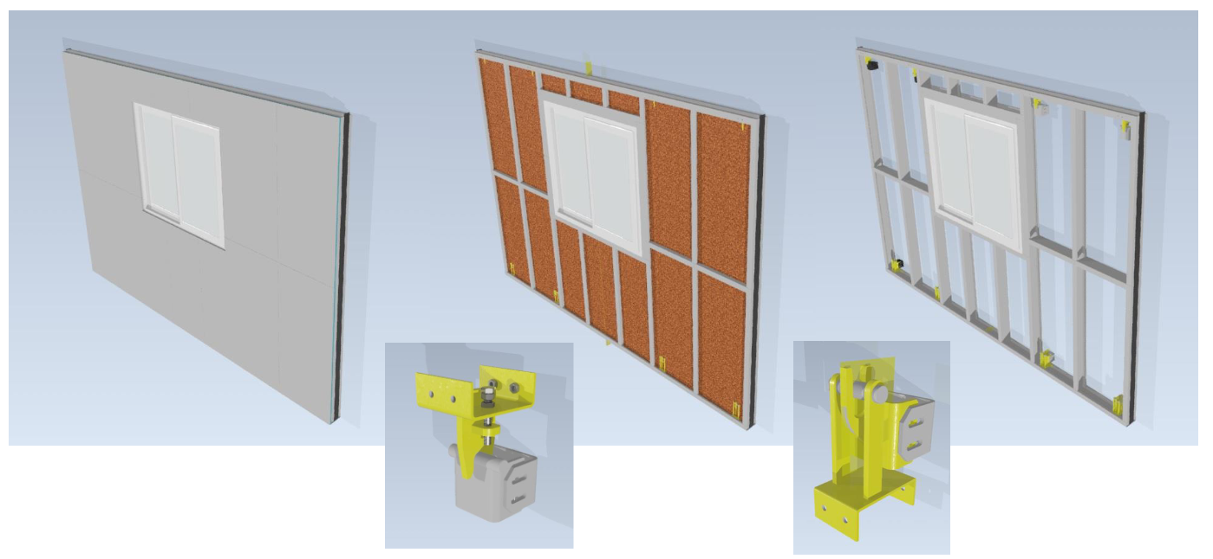
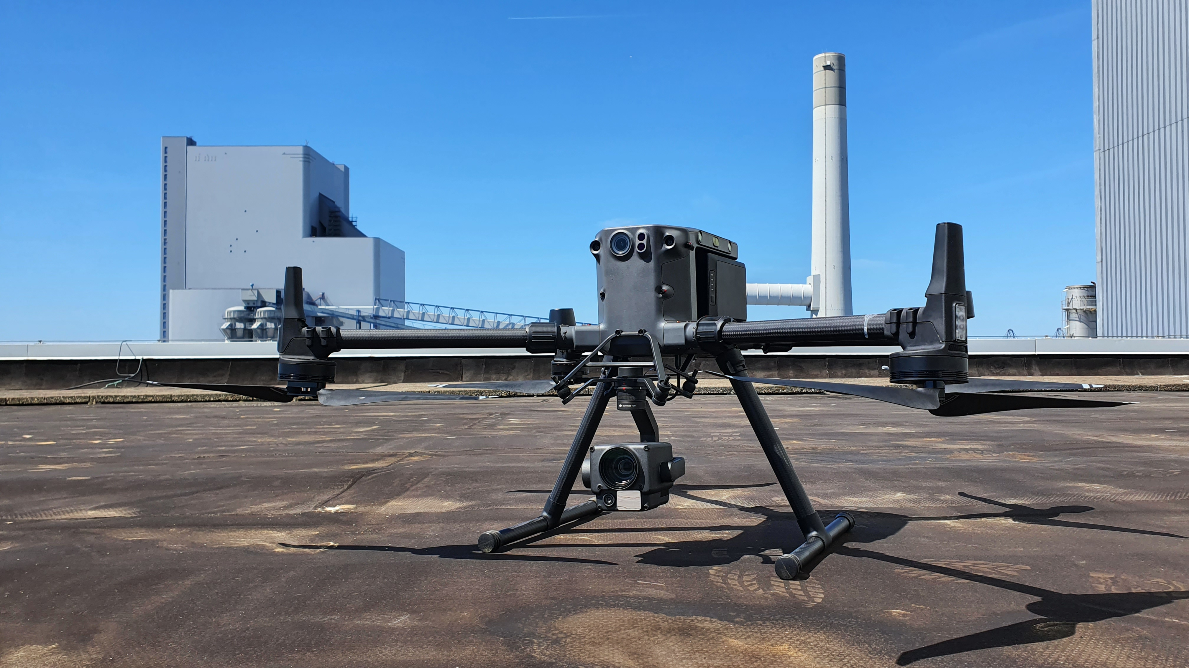
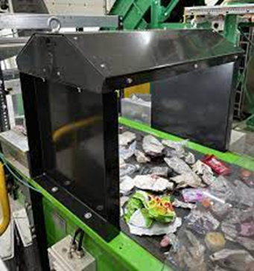
EU project InCUBE
WP1 : Foundations for Smartening and Accelerating Deep Renovations: InCUBE framework
WP2 : InCUBE Technological Pool of Solutions (Hardware-Driven Innovation)
WP3 : A digital-twin enabled Unified Design/ Construction/ Renovation process
WP4 : Enhanced evaluation and optimised renovation planning and retrofitting: Using Digital Twins for Data- driven decision making
WP5 : Reduced Performance Gap and Value Chain Interoperable Integration
WP6 : Upskilling and Gender Mainstreaming workforce
WP7: Transformation of Deep Renovation: InCUBE Demonstration, Evaluation and Impact Assessment
WP8 : Business Models and Roadmap to Innovation & Collaboration
WP9 : InCUBE Communication, Dissemination and Exploitation
WP10: Project Coordination and Management
InCUBE demos buildings – Trento , Zaragoza, Groningen
Before of the Italian demo – After of the Italian demo
Some technologies applied in the demos

Slide 5
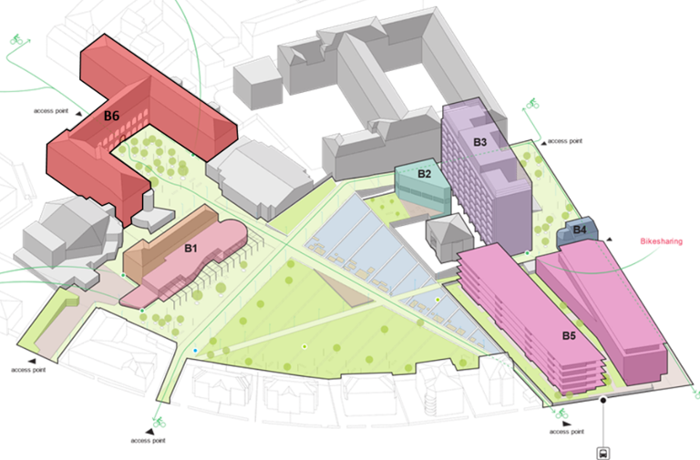
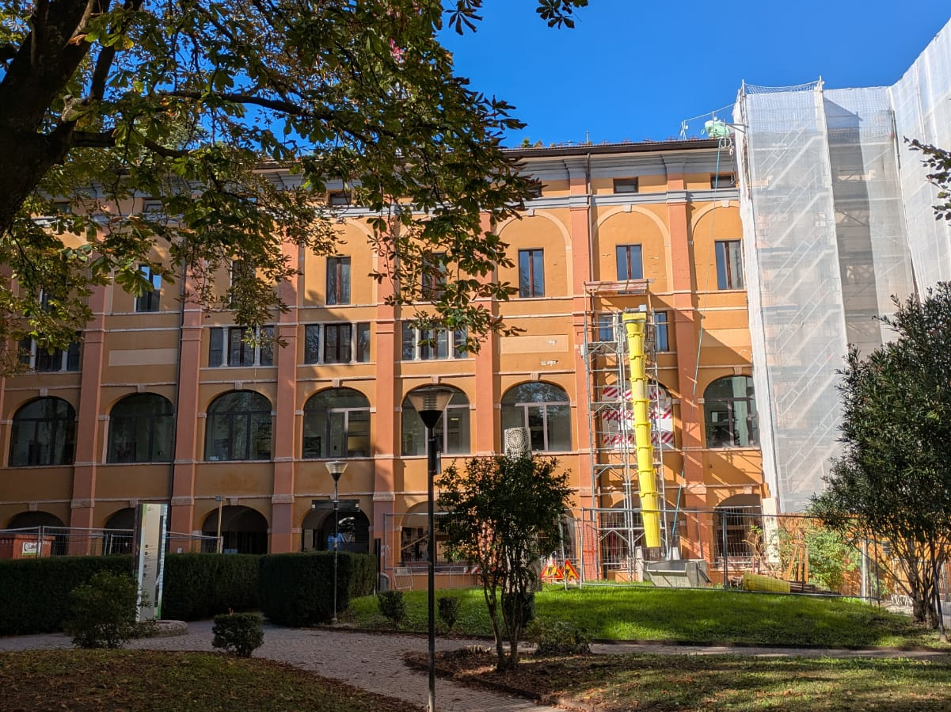
The InCUBE Trento demo site
Santa Chiara district (B1, B2, B3, B4, B5, B6) – Total floor area: 24368 m2 including gym e auditorium
Historical building B6
Floor area: historical part 5400 m2 and Palabocchi gym and Auditorium that are respectively 1080 m2 and 1458 m2.
Construction date: 1235 (1980)
Occupants/users: more than 1500 people
Energy Needs: 214 kWh/m²/y → 188 kWh/m²/y
Current RES production: 56 MWh/y → 339 MWh/y
EPC Class: D → B
Current SRI: 14.2% →85.7%

Slide 6

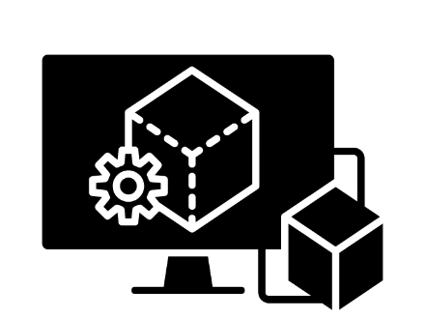


Context Building renovation
Building Renovation
Improve Energy Efficiency
Retrofit of outdated systems
Enhancing thermal insulation
Integrate renewable energy sources
Digital Twins
Digital replicas
Geometric Digital Twin (GDT)
Data integration layer
(real-time or historical data)
Simulations
Indoor conditions & Technological Systems
HVAC installation
Automated energy management
Energy-efficient lighting

Slide 7
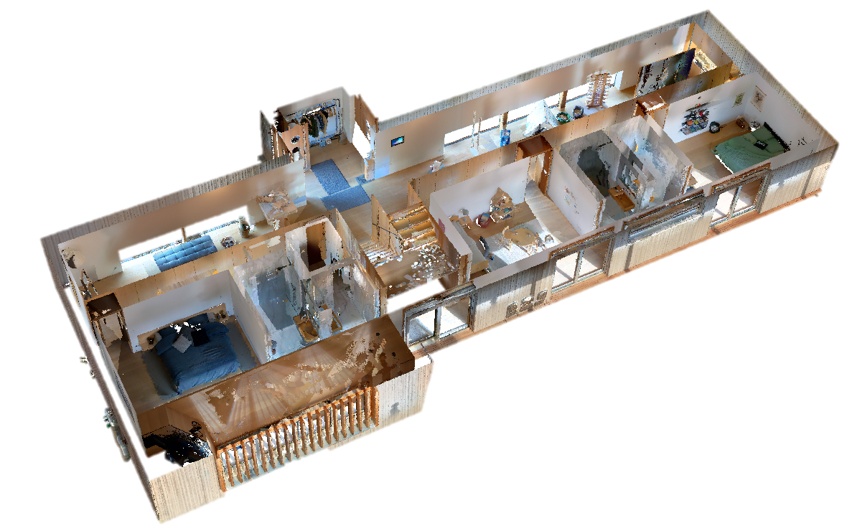
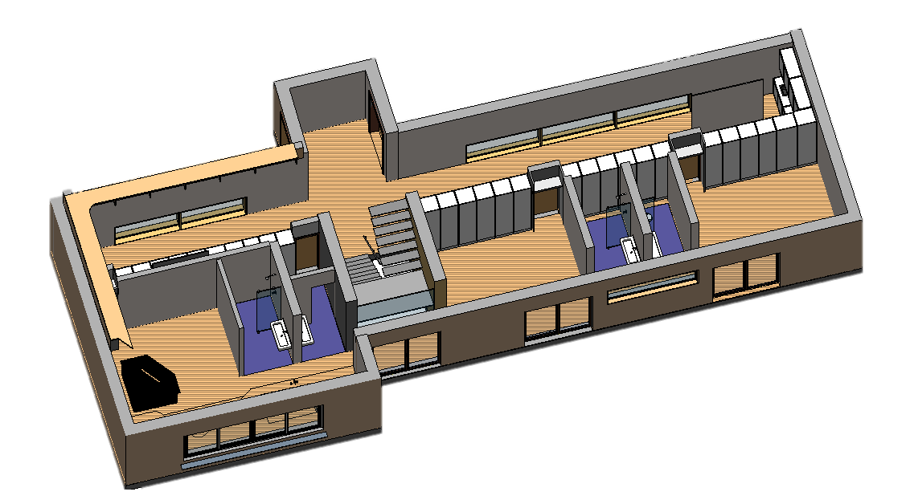




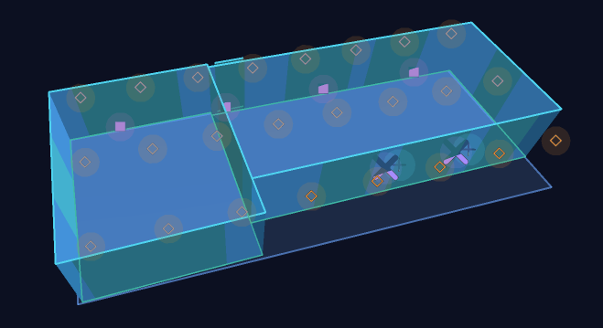
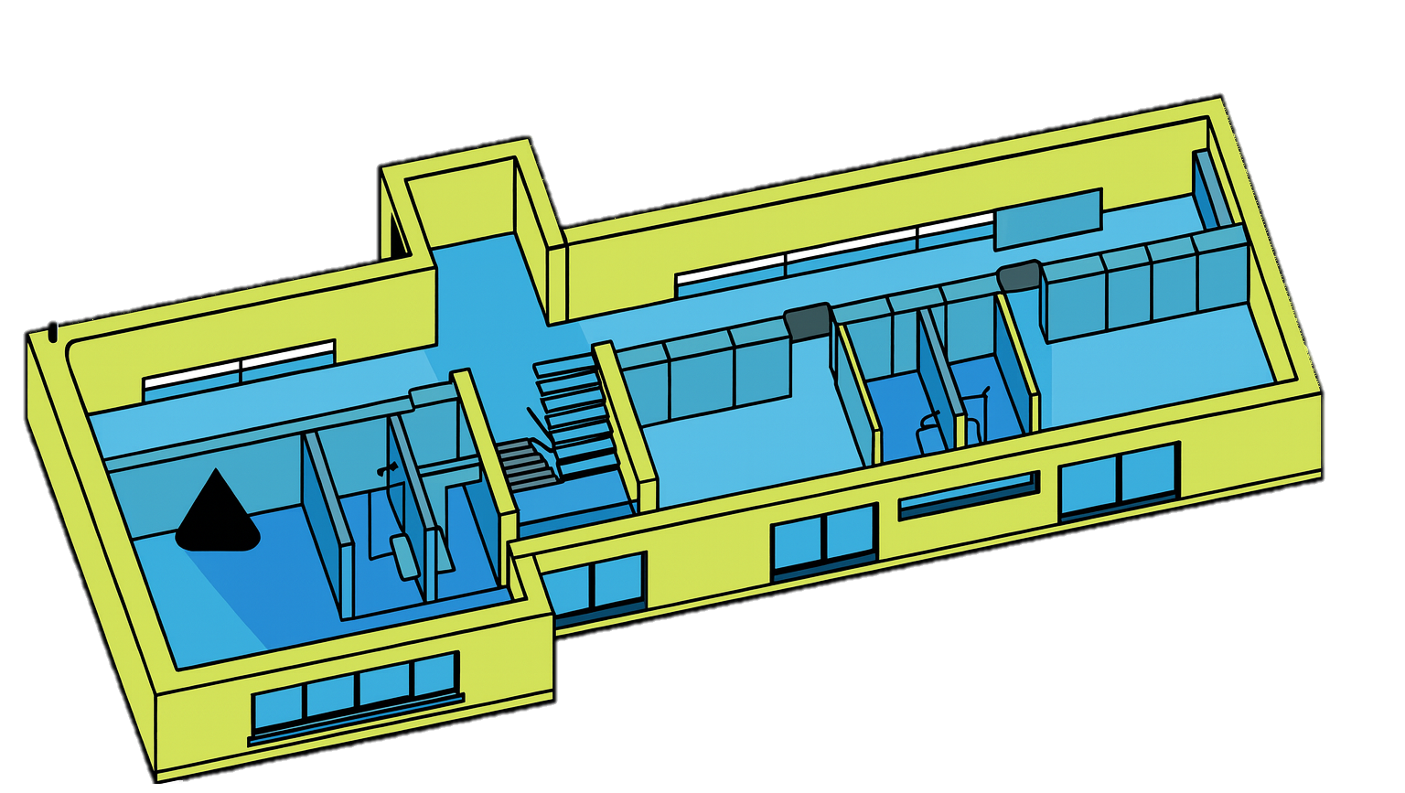


Current workflows for digital twins General common workflows
3D reconstruction, Scan-to-BIM, meshing, semantic enrichment
3D surveying (Photogrammetry, LiDAR, drone, etc.)
3D geometric model, Building Information Model (BIM)
Link to the real world object
Enrichment with energy components (static information)
Energy Digital Twin
Building Energy Model (BEM)
Enrichment with dynamic data and analytics
Boundary representation (B-Rep) models for simulations

Slide 8
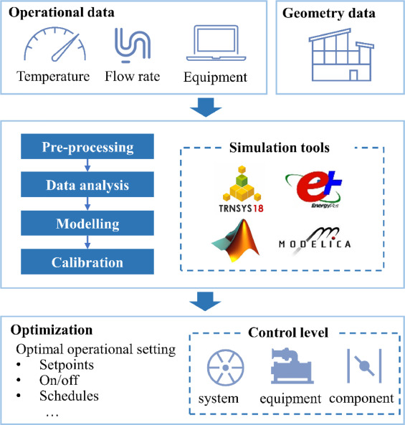



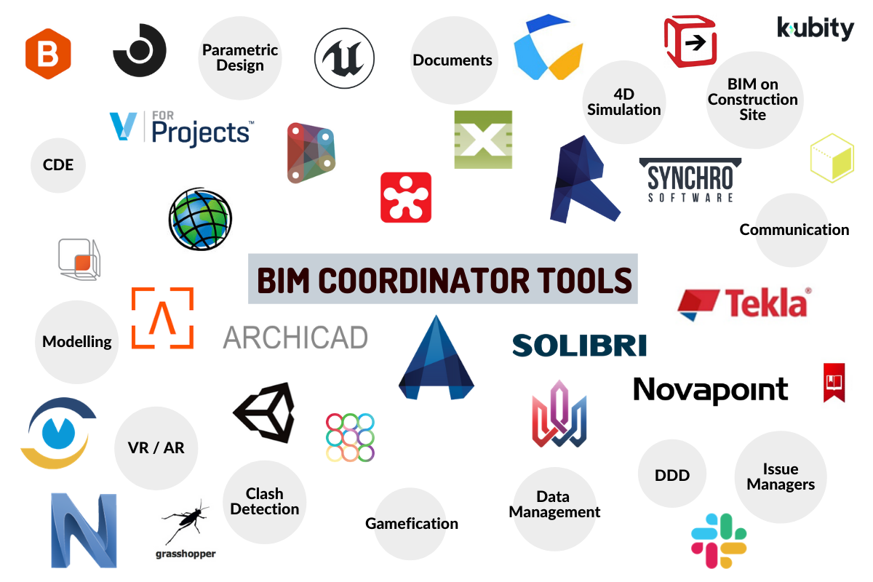
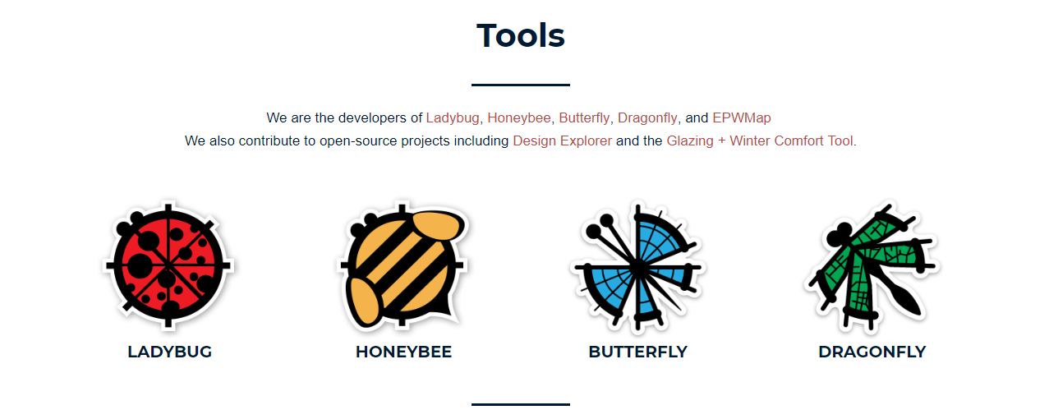
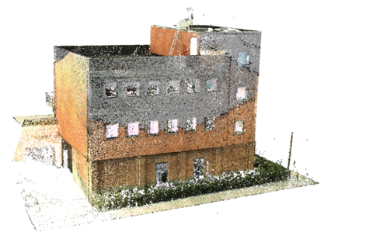


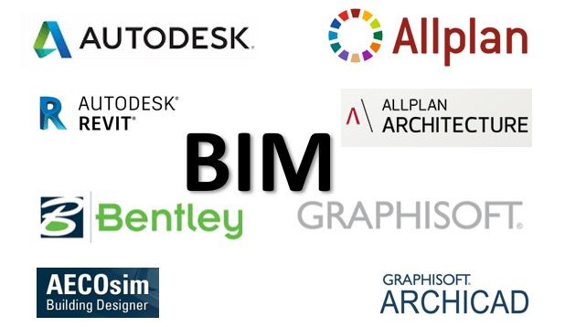


Current workflow Energy analysis from 3D point clouds
Many processing steps/Software (mostly commercial) – Compatibility issues/frequent loss of data
UNSTRUCTURED POINT CLOUD
BIM / DT SOFTWARE
ENERGY ANALYSIS
SCAN-TO-BIM
RESULTS

Slide 9
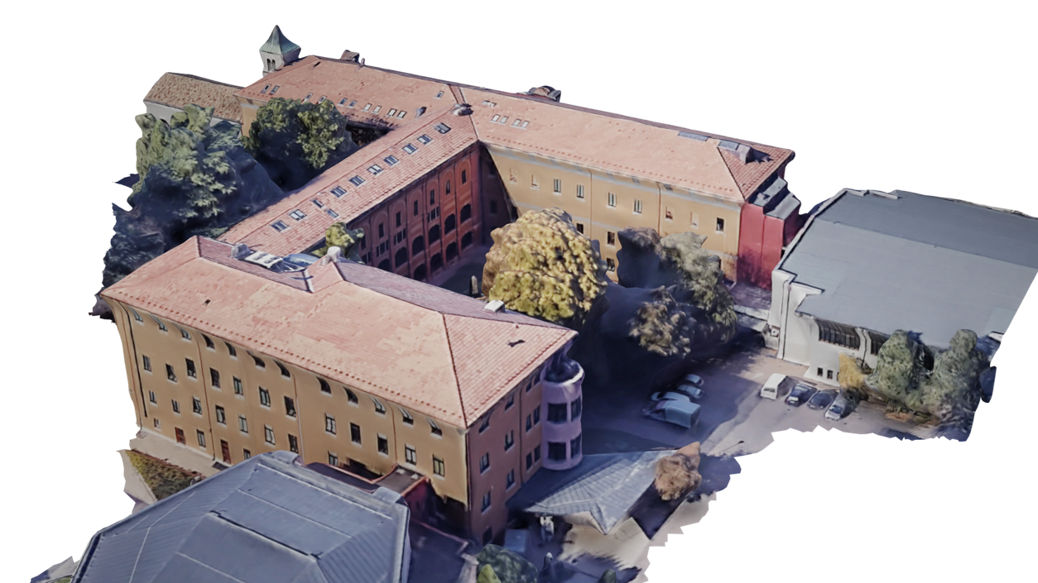
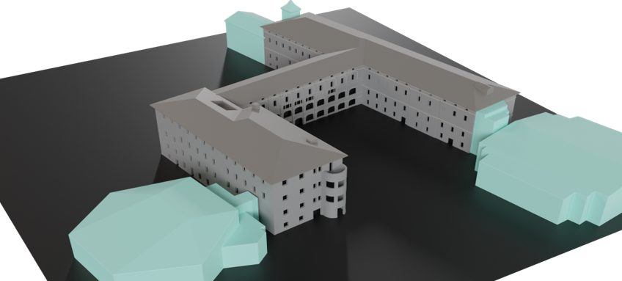
The InCUBE Trento demo site
(1) 3D modelling of the general building envelope with aerial data

Slide 10
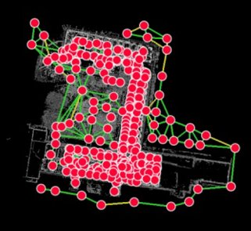
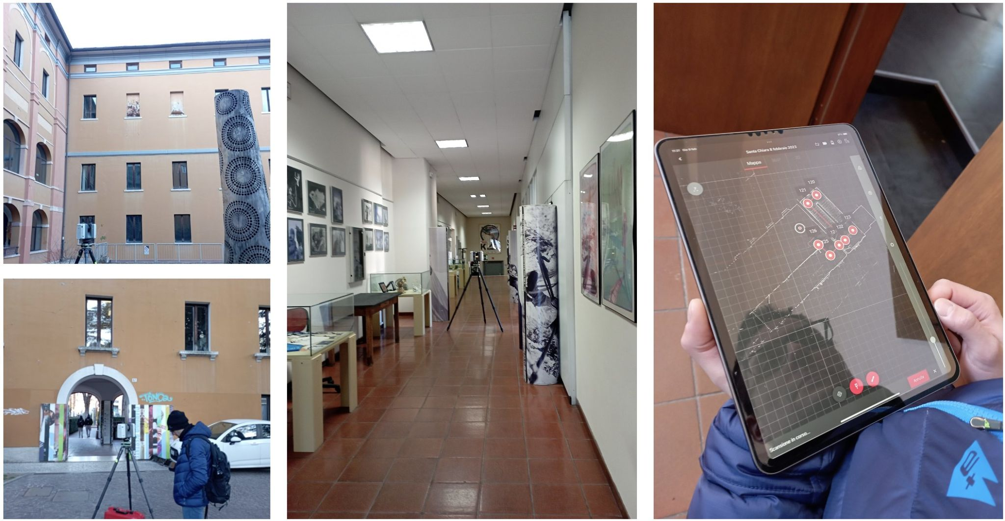
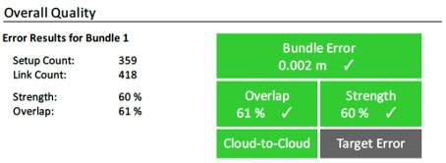
The InCUBE Trento demo site
(2) 3D surveying/TLS (Leica RTC360) / façades and indoor (about 360 scans) B6 block

Slide 11
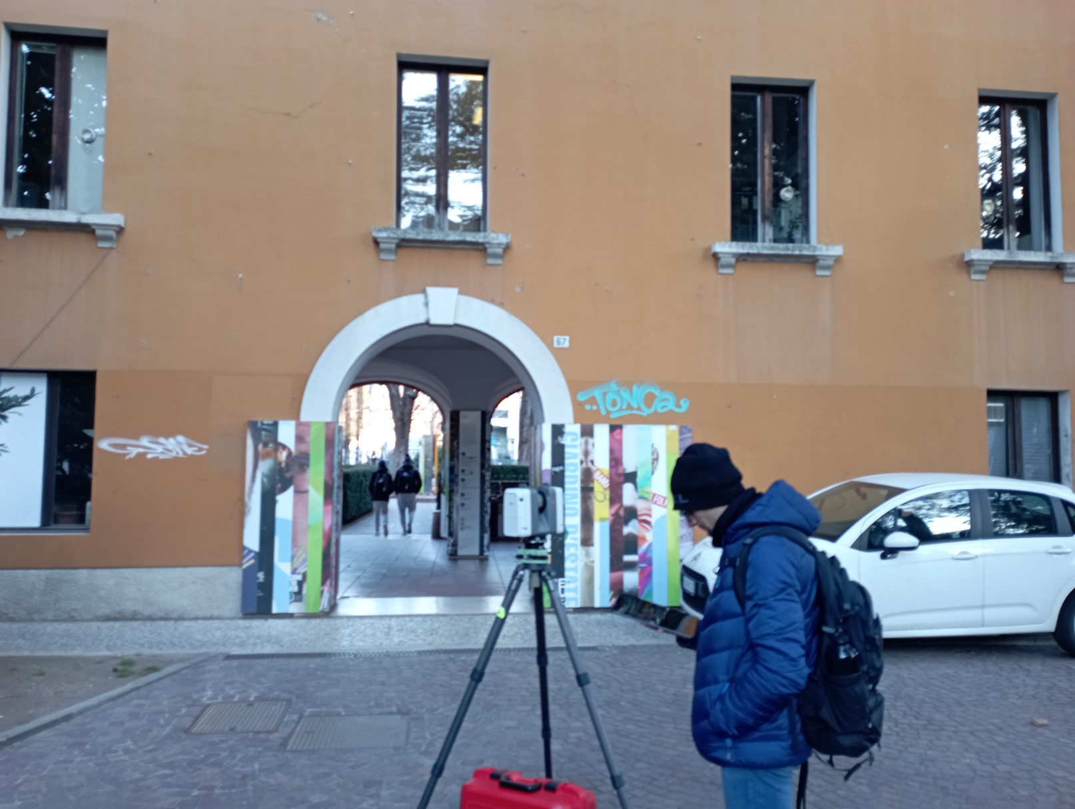
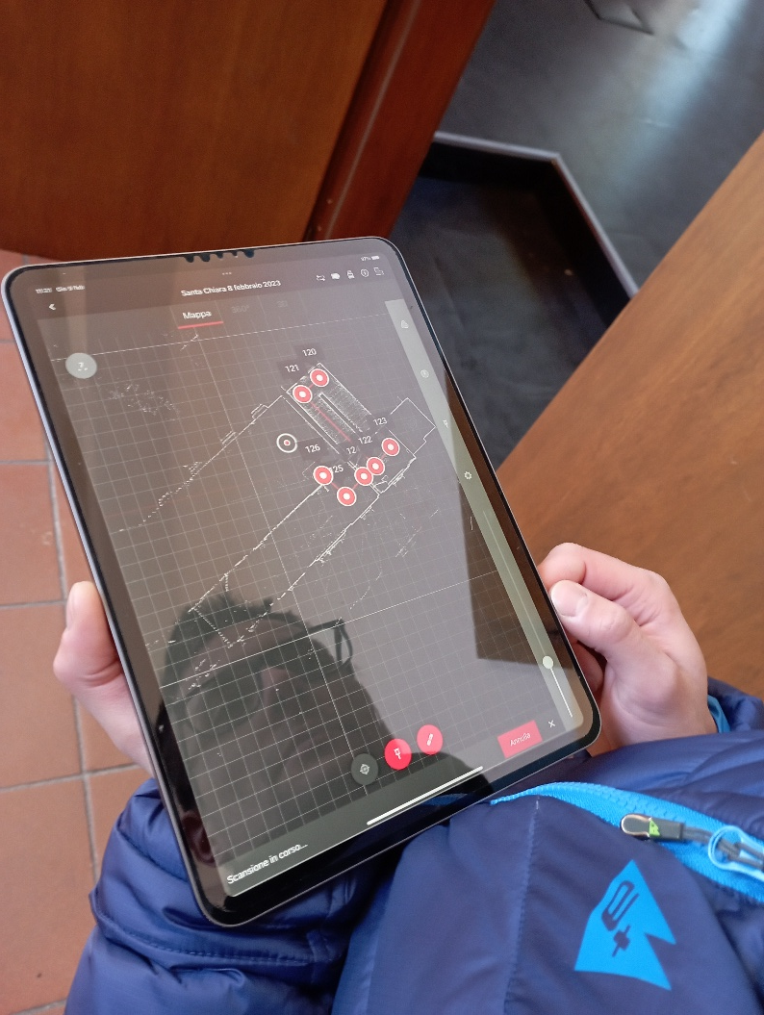
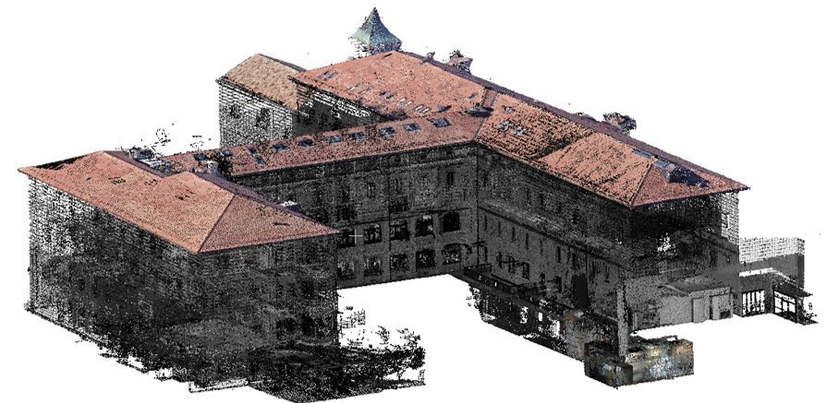
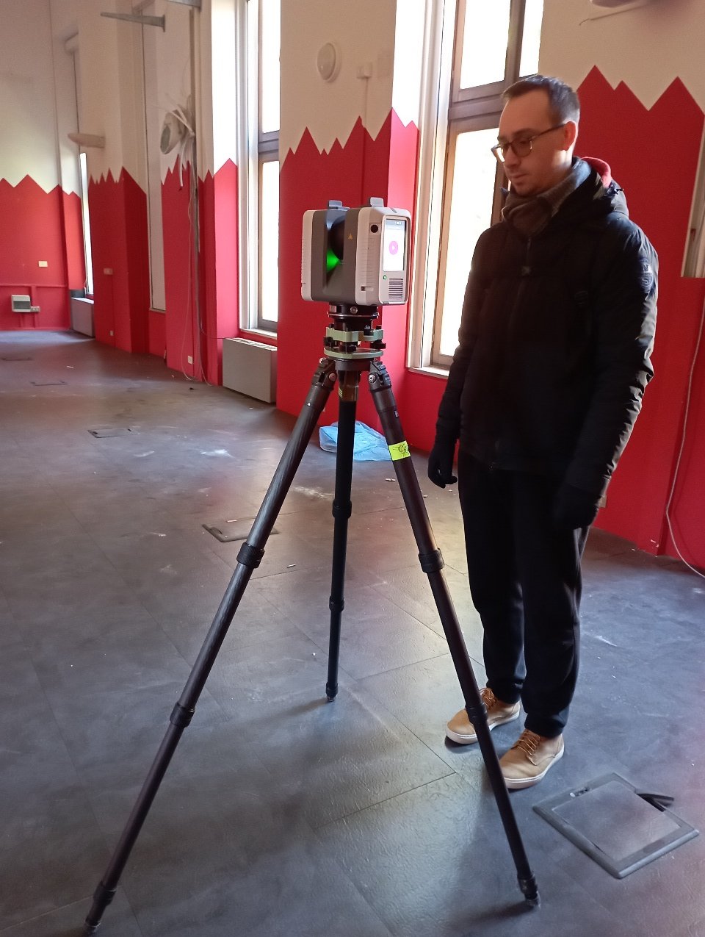
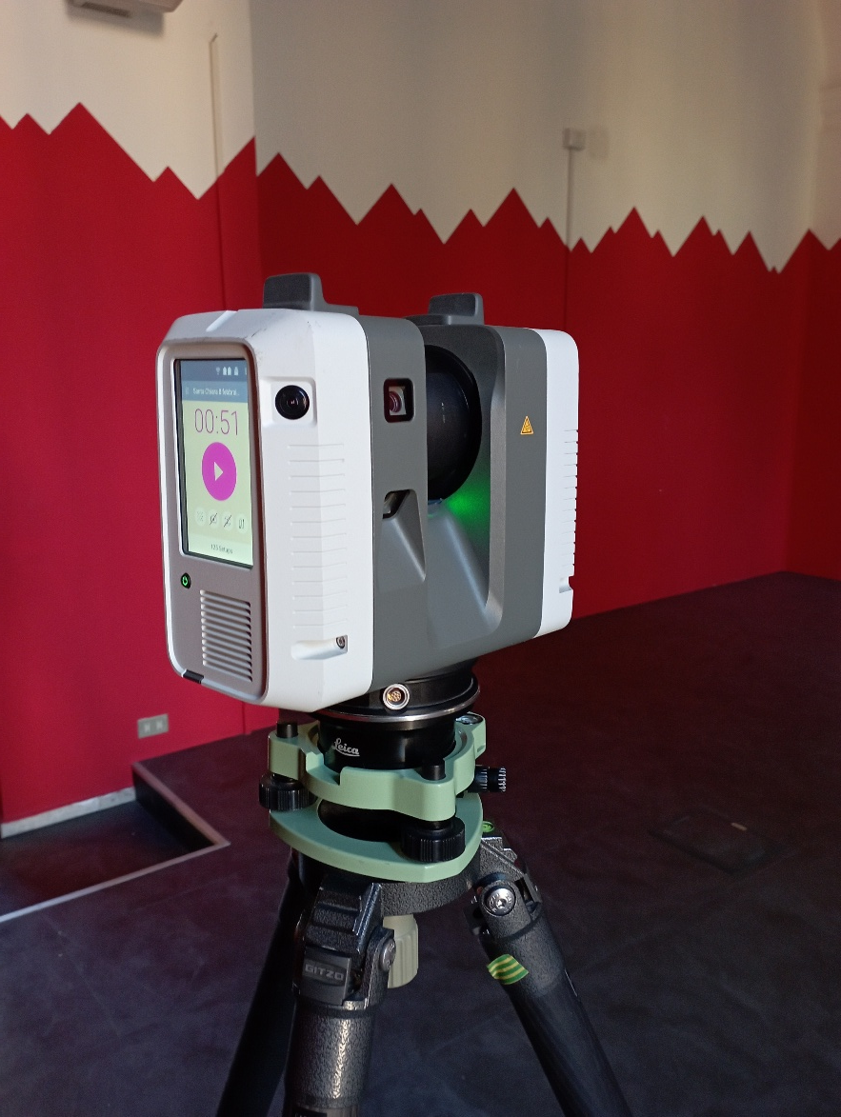
InCUBE 3D reality-based surveying and 3D modelling
Current regulations impose some flight restrictions in urban areas for safety reasons. To generate the BIM models instead of UAV/drones there was the need to use terrestrial laser scanning (TLS) techniques.

Slide 12
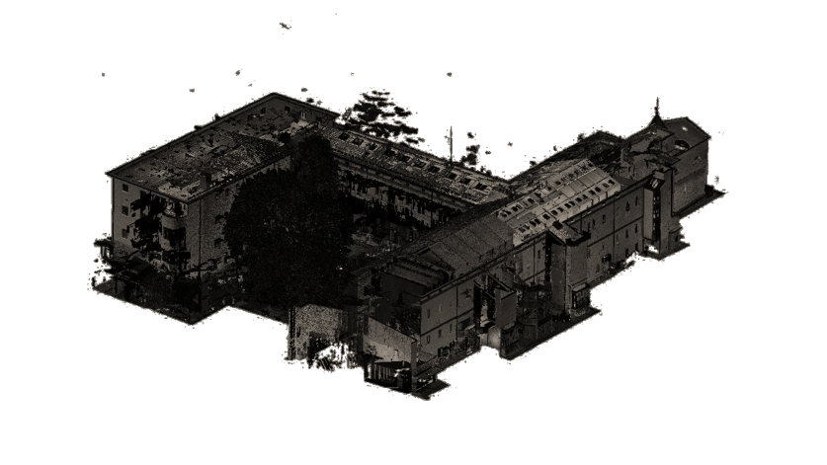
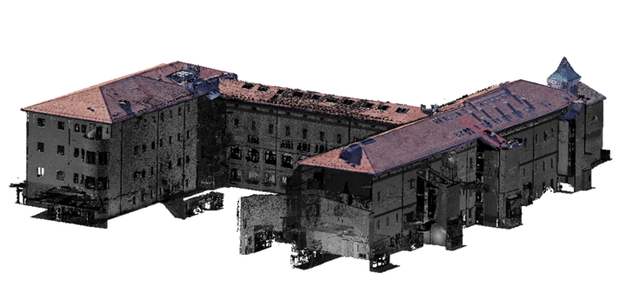
The InCUBE Trento demo site
(3) Cleaning and resample of point clouds

Slide 13
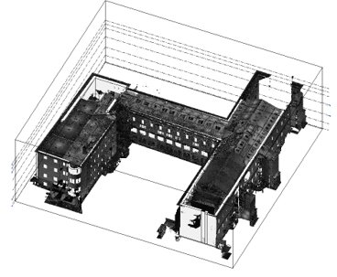
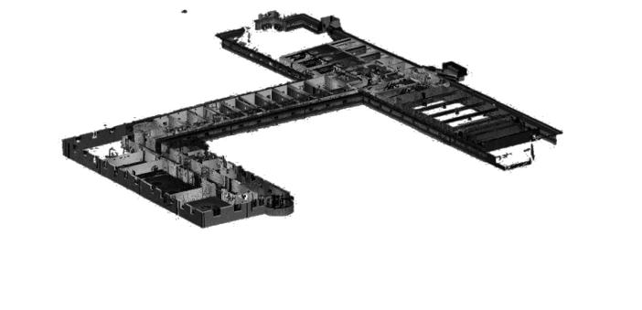
The InCUBE Trento demo site
(4) Data fusion/ multi-resolution and complete 3D final point cloud

Slide 14
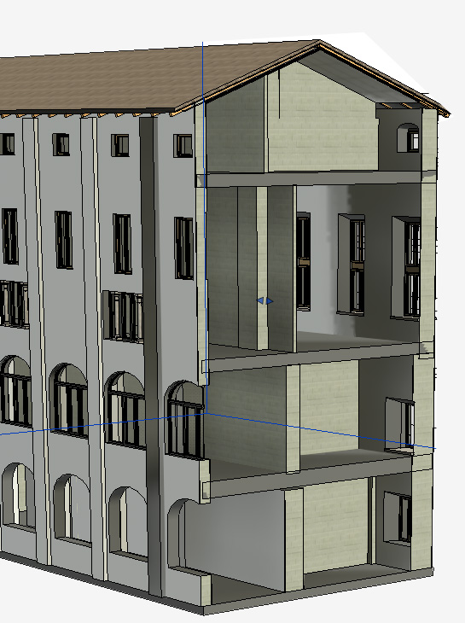
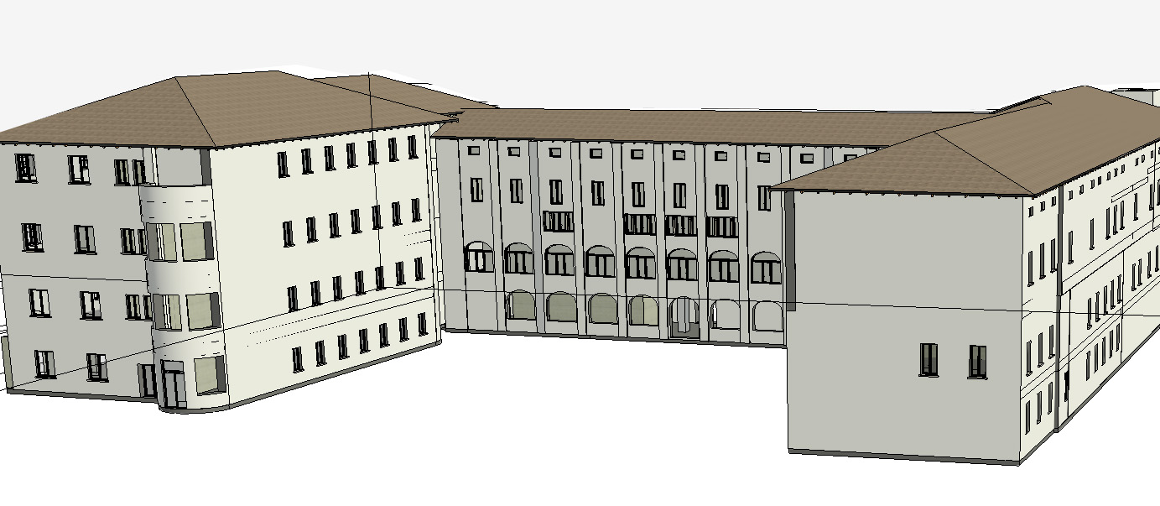
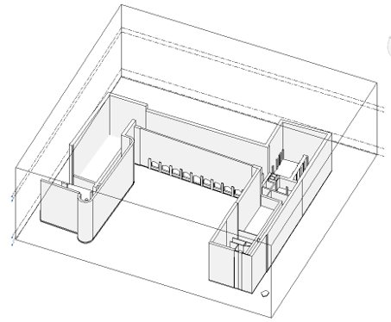
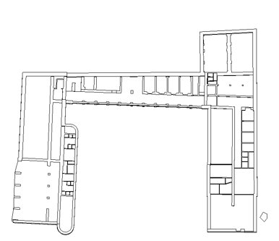
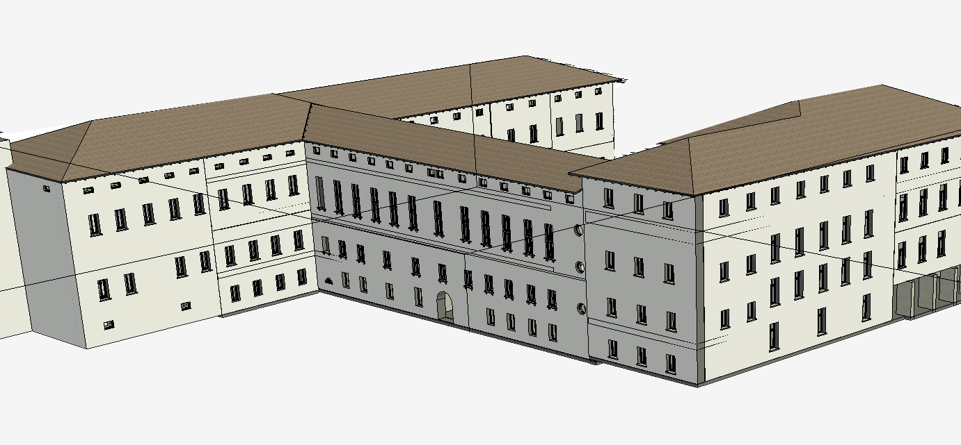
The InCUBE Trento demo site
(5) Geometrical BIM model

Slide 15
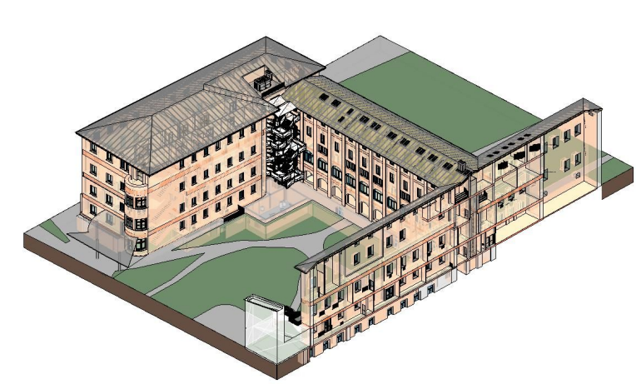
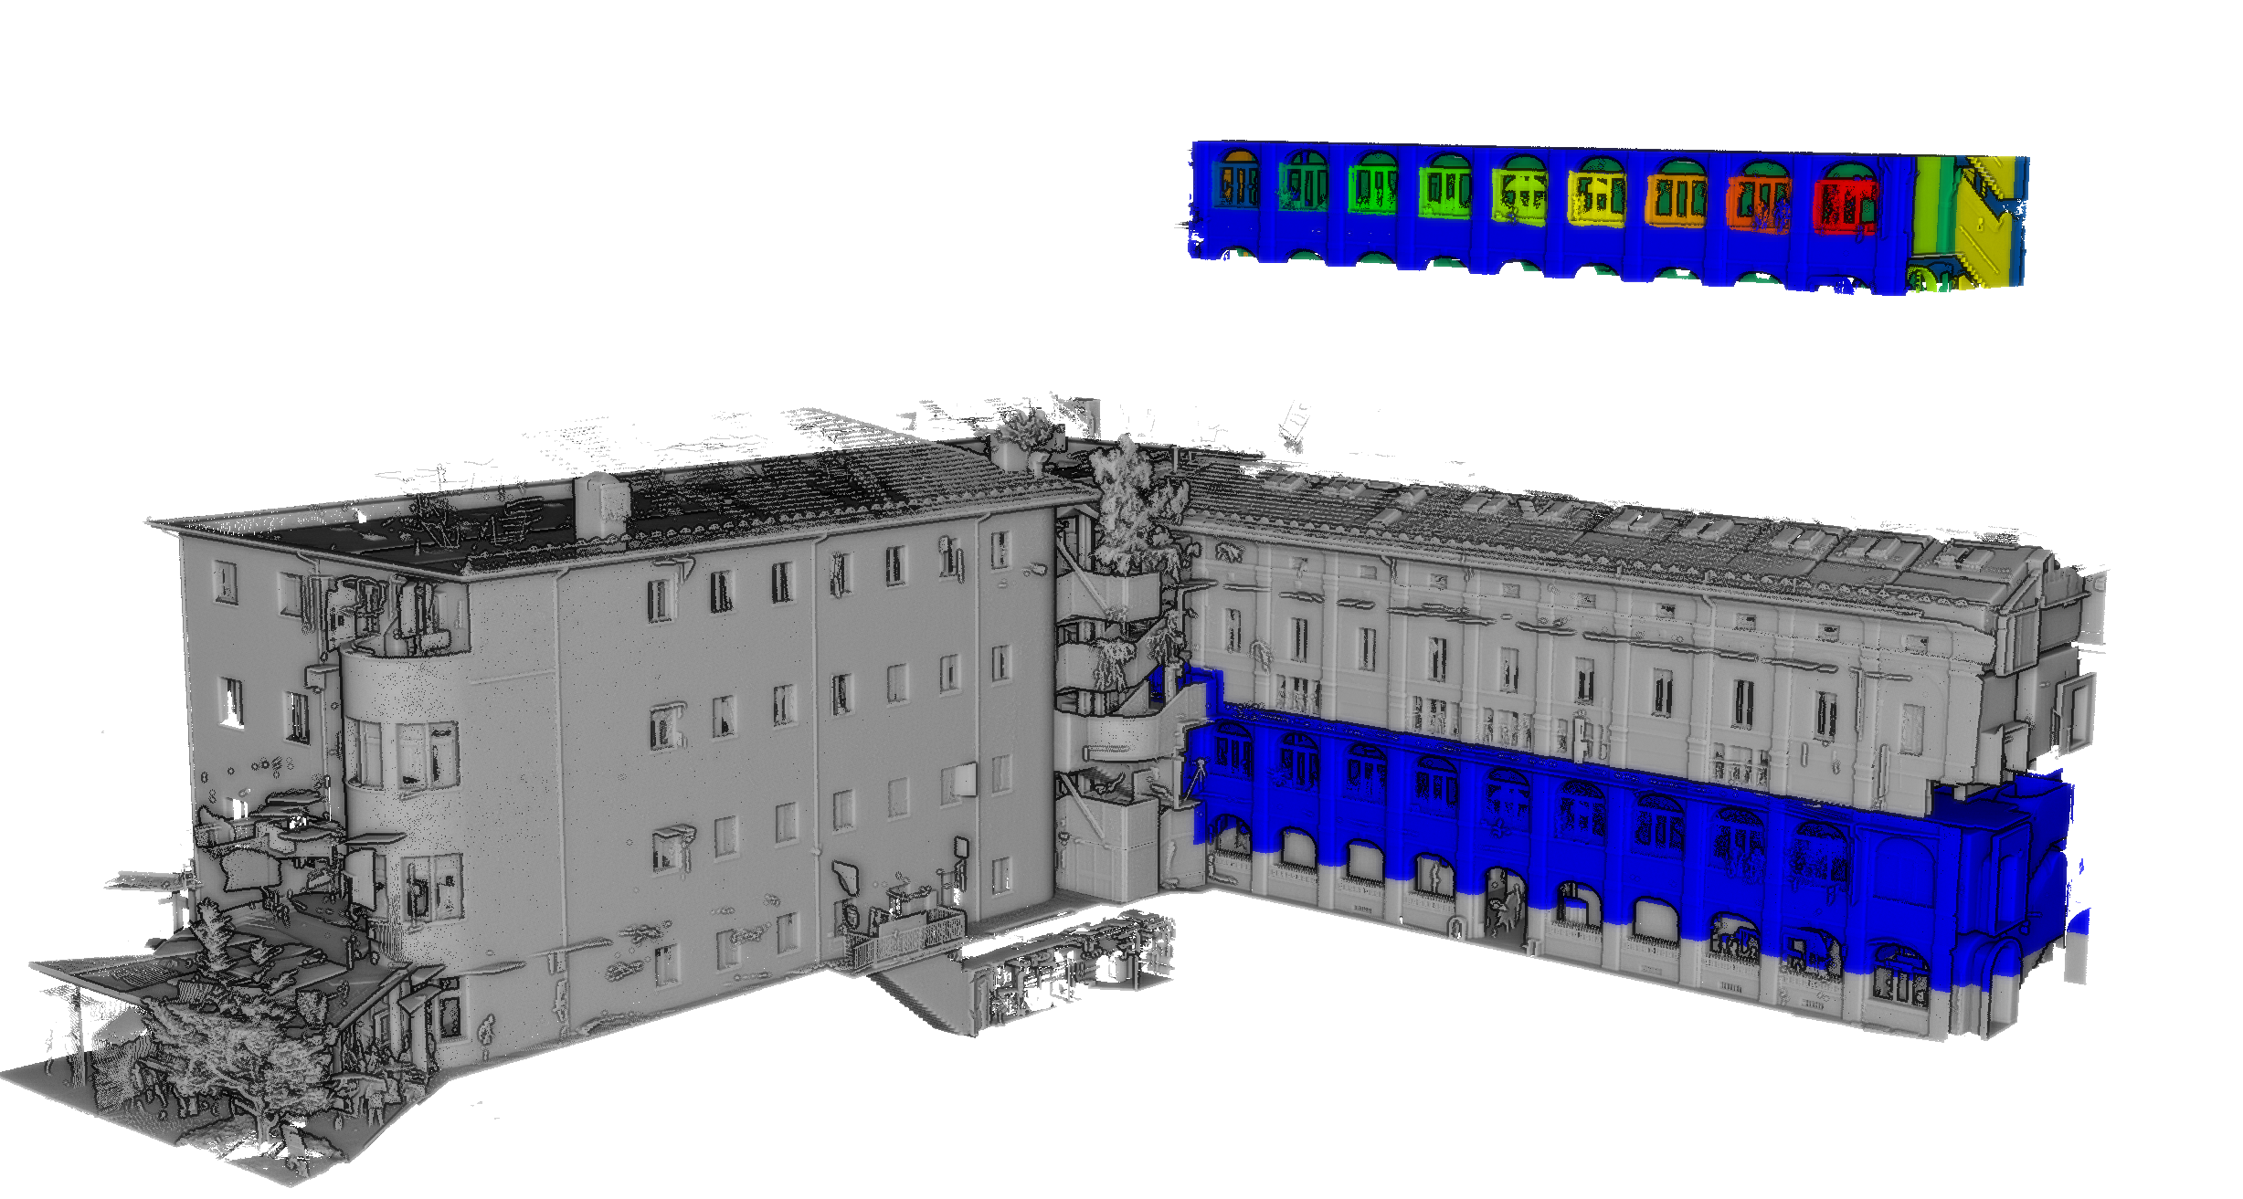
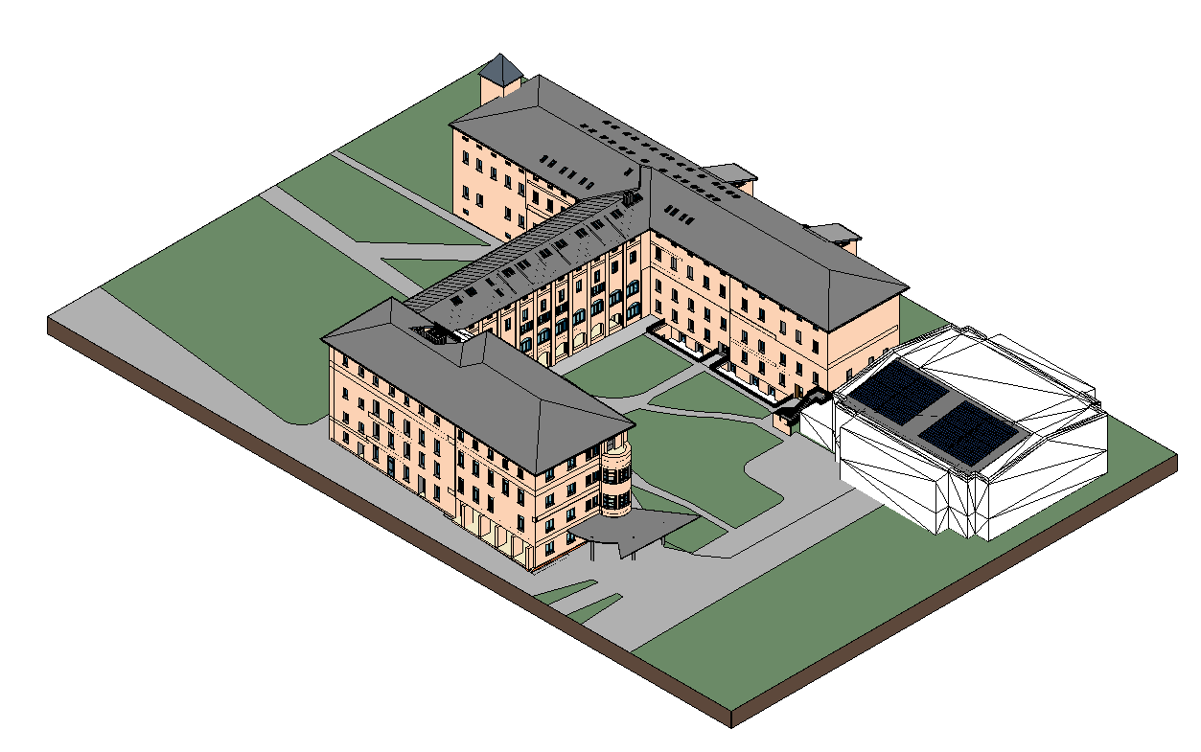
BIM to BEM Workflow
TLS dataset
BIM model
https://github.com/3DOM-FBK/InCUBE

Slide 16
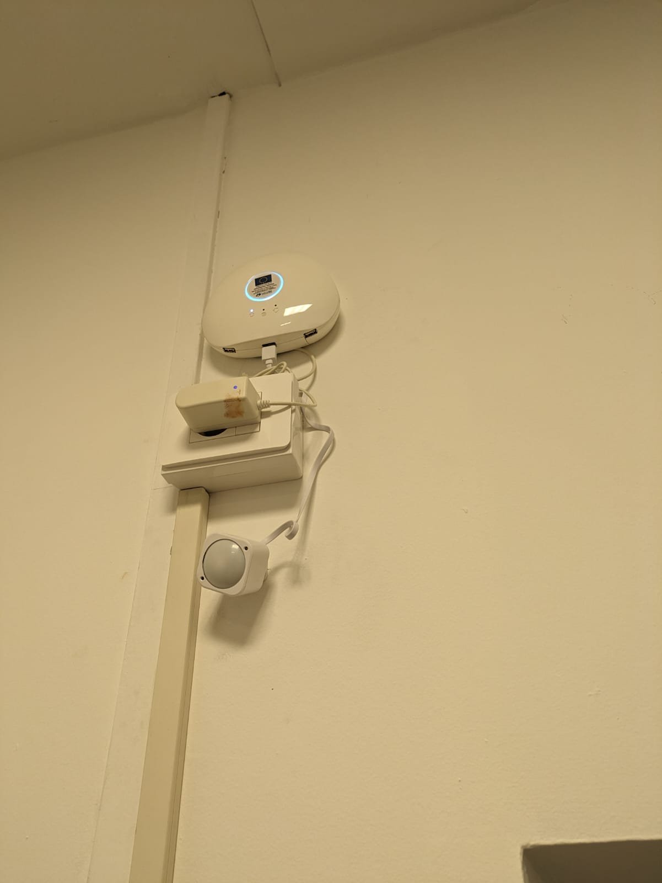
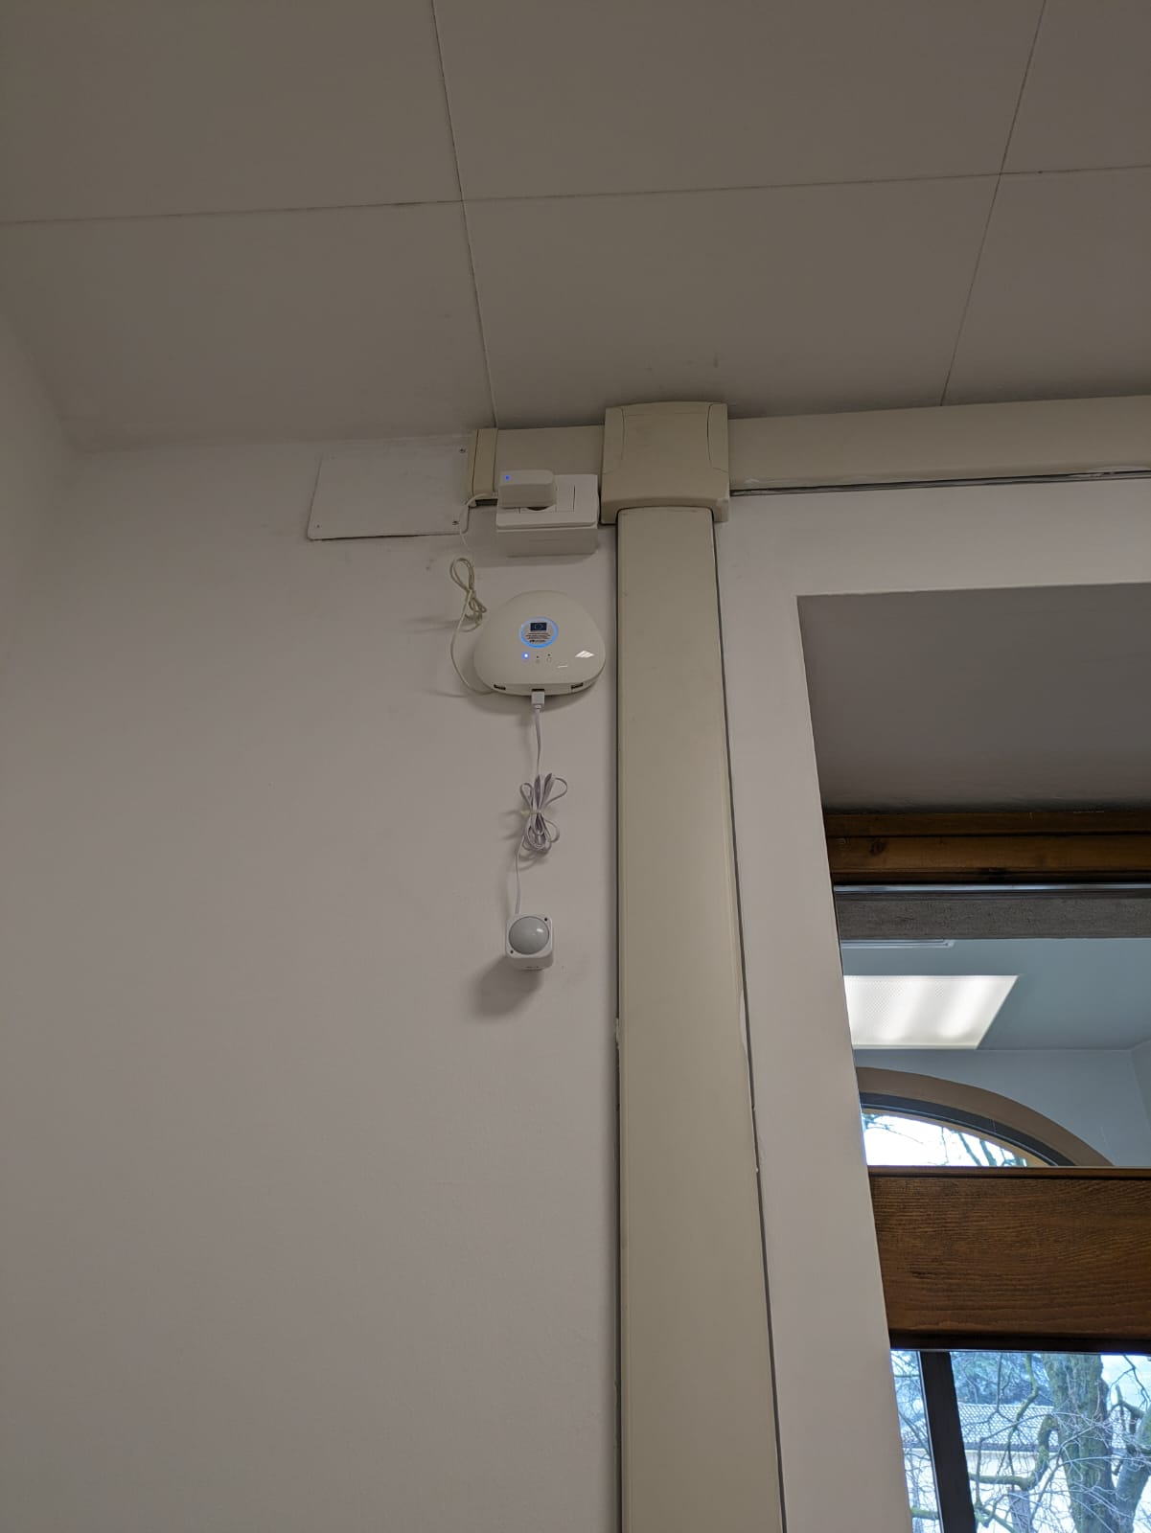
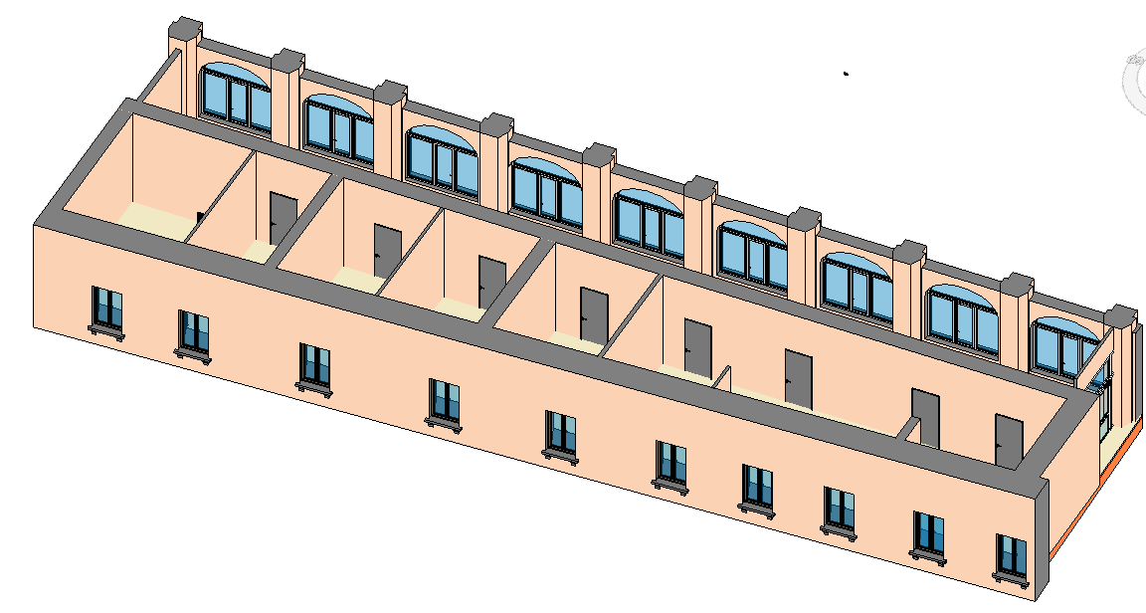
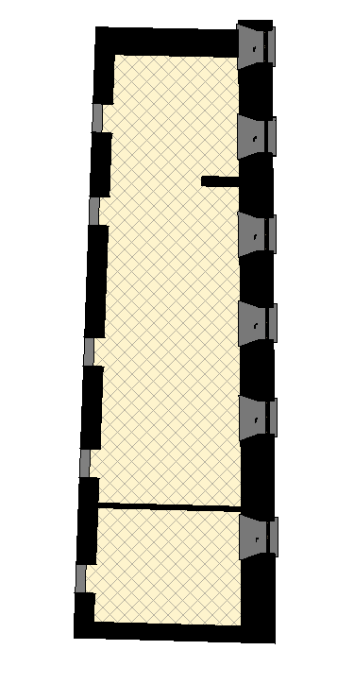
BIM to BEM Workflow
Zone A2 - sensor_02
Zone A1 - sensor_01
Zone_A2
Zone_A1
IoT EDGE COMPUTER
SMART PLUGS
MULTISENSORS
sensor_01
sensor_02

Slide 17


BIM to BEM Visualization and predictive models
Z-sensors energy consumpition data are visualized in a dedicated dashboard
Foundational time series forecasting models are trained (few shot with different % of historical data) for predicting the next 24 hours of energy demand

Slide 18

BIM to BEM Workflow
Zone A2 - sensor_02
Zone A1 - sensor_01
Zone_A2
Zone_A1
6-months temperature data
IoT EDGE COMPUTER
SMART PLUGS
MULTISENSORS

Slide 19

























BIM to BEM Workflow
3
CFD SIMULATIONS AND ANALYSIS
2C
ENERGY-RELATED INFORMATION (.JSON)
UNSTRUCTURED POINT CLOUD
WALL MASKS
EXTRACTION
4
2A
GEOMETRIC DIGITAL TWIN (gDT)
5
RESULTS
2B
TOPOLOGIC MODEL (TBIM)
6
SENSOR PLACEMENT AREAS
REAL TIME DATA AND MODEL VALIDATION
t = t_{i}+ t_{(i + 1)}
1A
3A
CLASSIFIED POINT CLOUD
2D
INFORMATIONAL LOAD DICTIONARIES
(ILD)
GEOMETRIC RECONSTRUCTION PROCESS
ENERGY ANALYSIS

Slide 20








BIM to BEM Workflow
Classified point cloud
1. geometric DT
1
2
2. Topologic (TDM)
3. Model for simulations
3
[Roman, O., Mazzacca, G., Farella, E. M., Remondino, F., Bassier, M., and Agugiaro, G.: Towards Automated BIM and BEM Model Generation using a B-Rep-based Method with Topological Map, ISPRS Ann. Photogramm. Remote Sens. Spatial Inf. Sci., X-4-2024, 287–294.]

Slide 21



BIM to BEM Workflow
Classified point cloud
Floorplan extraction
1. geometric DT
2. Topologic (TDM)
3. Model for simulations

Slide 22
BIM to BEM Workflow
Classified point cloud
TBIM - VOLUMETRIC MODEL
Volume
Room Type
# Thermal zone
Temperature setpoints
Orientation
# devices inside
ENERGY MODEL
Class_id
Area
U-value
Internal\External walls
1. geometric DT
2. Topologic (TDM)
3. Model for simulations

Slide 23

Digital twin From BIM to BEM
InCUBE Conceptual architecture

Slide 24
Digital twin From BIM to BEM
Taki it and transform in json format and trasform it a data model – we pick most relevant information surface/year/material and level of details
Sensinac iot platform
Eclipse foundation and it is open
Data model that rapresent this data – simple but effective
Sensors in general
Transfor model in senac rapresentation through digital twin

Slide 25

BIM to BEM Workflow
Developments on the back-end
Improved file handling methods and revised the file paths to consider the site name and the different document categories
Added integration of the DBL with BIM IFC files of the buildings
BIM IFC format → CSV format → JSON format
Covered aspects: Building, Storey, Space
New webservice getBIMinfo: /getBIMinfo?site=ITDEMO&aspect=building

Slide 26

BIM to BEM Workflow
Development of the web-based UI
Login page

Slide 27

BIM to BEM Workflow
‘Dashboard’ section

Slide 28

BIM to BEM Workflow
‘Monitoring’ data section

Slide 29

BIM to BEM Workflow
Documents section
Organised by document types
Sorting by column
Search box

Slide 30


BIM to BEM Workflow
Management section

Slide 31


InCUBE Digital twins
Digital Twin – Integration Activities
S-BEMS for real-time data
Integration of historical data (statistics) and KPIs
Logbook for BIM and BIM2BEM data

Slide 32

InCUBE Digital twins
Digital Twin – User Interface
Customizable interface for each demo site
2D representation of products
3D representation of buildings

Slide 33
thank you.

